Slide 1

DEEPAK HEGDE
Dhegde147@gmail.com

Slide 2
Objective:
To analyze the performance of different sectors over the years from 2000 to 2005.

Slide 3



Investment is a game of understanding historic data of investment objects under different events but it is still a game of chances to minimize the risk we apply analytics to find the equilibrium investment.
To understand the Foreign direct investment in India for the last 17 years from 2000-01 to 2016-17. This dataset contains sector and financial year-wise data of FDI in India Sector-wise investment analysis Year-wise investment analysis.
Find key metrics and factors and show the meaningful relationships between attributes. Do your own research and come up with your finding
PROBLEM STATEMENT

Slide 4
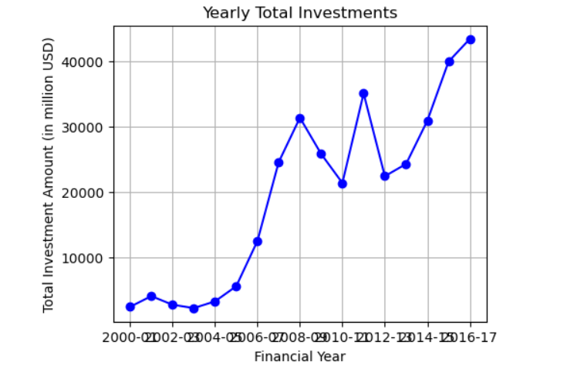
INSITE : 2
Interpretation:
The line plot shows a significant increase in total FDI in India from 2004-05 to 2008-09, followed by some fluctuations. After a dip around 2012-13, investments have consistently risen, peaking in 2016-17. This indicates an overall positive trend in FDI over the analyzed period.

Slide 5
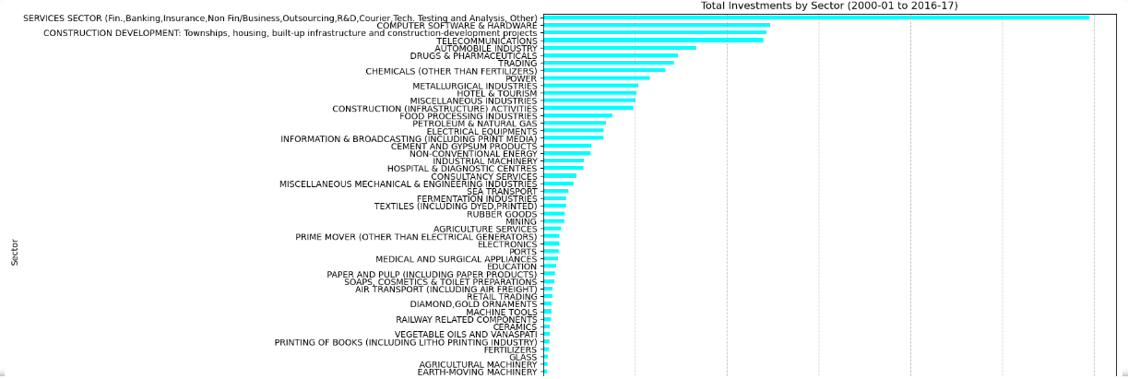
INSITES :1
Interpretation:
Top Sectors:
Services Sector: Received the highest total investment, indicating strong interest in finance, banking, insurance, and other services.
Construction Development: Significant investments in infrastructure projects like housing and townships.
Computer Software & Hardware: Major investments reflecting the importance of the tech sector.
High Investment Sectors:
Telecommunications, Automobile Industry, Drugs & Pharmaceuticals, and Trading also attracted substantial investments, showcasing their critical roles in the economy.

Slide 6
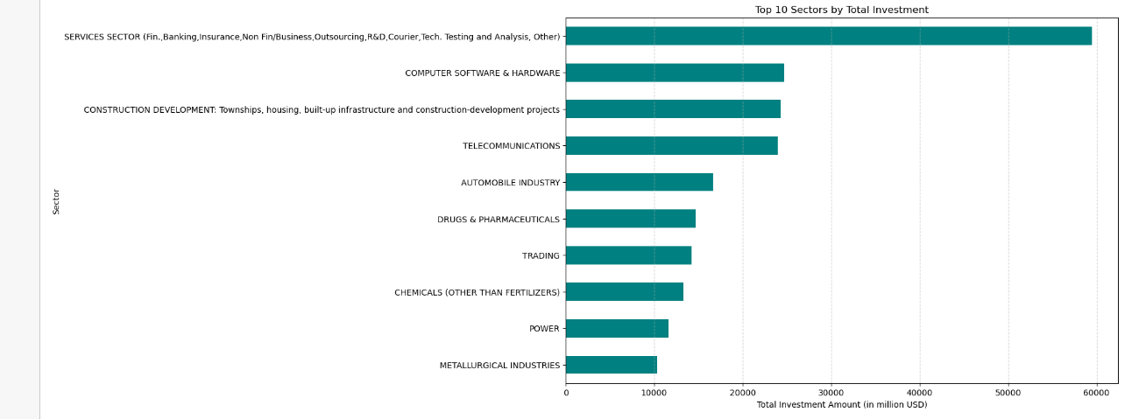
Top 10 Sectors by Total Investment
Key Insights:
The Services Sector dominates FDI, showcasing its critical economic role.
Infrastructure and technology sectors attract major investments, reflecting development needs and growth potential.
Healthcare and chemical industries also receive significant investments, indicating their economic importance.

Slide 7
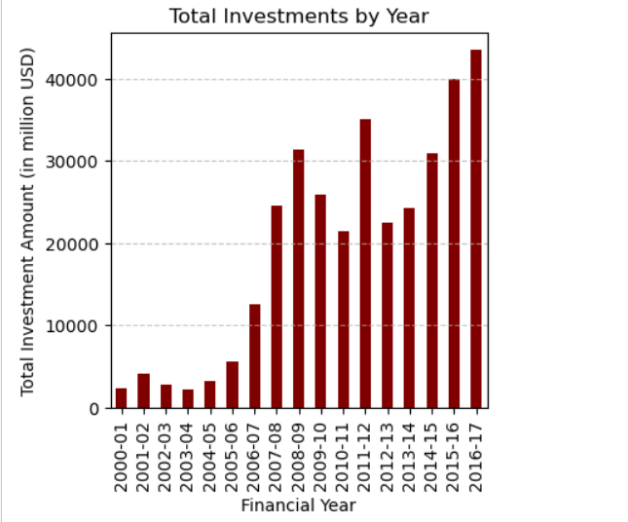
INSITE: 3
Interpretation
Upward Trend:
The plot shows a general upward trend in total investments from 2000-01 to 2016-17, with significant increases starting around 2006-07.
Peaks and Valleys:
Notable peaks are observed in 2008-09, 2011-12, and 2016-17, indicating years of particularly high investment.
There are also valleys, such as in 2009-10 and 2012-13, where investments dipped compared to the previous years.
Record Year:
The highest total investment was recorded in 2016-17, reaching over 40,000 million USD.
This analysis highlights the substantial growth in FDI over the years, with some fluctuations, and emphasizes 2016-17 as a standout year for investments.

Slide 8
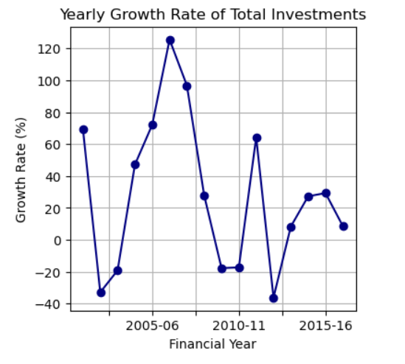
Insight :
The FDI inflows to India have experienced substantial fluctuations, indicating varying investor confidence and possibly external economic factors influencing these trends.
Despite the volatility, there are several periods of strong growth, underscoring the potential for significant investment opportunities.
This analysis highlights the importance of understanding the factors driving these changes to better predict future investment trends.

Slide 9
Conclusion :
The analysis of the Investment Concentration Ratio over the years reveals fluctuations in how concentrated FDI investments have been within the top 5 sectors. The trend towards decreasing concentration in recent years indicates positive diversification, which should be further encouraged through targeted policies and incentives. Monitoring periods of high concentration and ensuring balanced growth across sectors will help in sustaining a robust and diversified economic environment attractive to foreign investors.

Slide 10


